Slide 1
Bubble Sort
By Surya Teja Chandolu

Slide 2
Bubble Sort
Bubble sort is a simple sorting algorithm. This sorting algorithm is a comparison-based algorithm in which each pair of adjacent elements is compared and the elements are swapped if they are not in order.

Slide 3
Bubble Sort
32 | 18 | 25 | 75 | 55 | 2 | 40
2 | 18 | 25 | 32 | 40 | 55 | 75

Slide 4
Bubble Sort
32 | 18 | 25 | 75 | 55 | 2 | 40
18 | 32 | 25 | 75 | 55 | 2 | 40
18 | 25 | 32 | 75 | 55 | 2 | 40
18 | 25 | 32 | 75 | 55 | 2 | 40
15 | 25 | 32 | 55 | 75 | 2 | 40
15 | 25 | 32 | 55 | 2 | 75 | 40
15 | 25 | 32 | 55 | 2 | 40 | 75

Slide 5
Bubble Sort
15 | 25 | 32 | 55 | 2 | 40 | 75
15 | 25 | 32 | 55 | 2 | 40 | 75
15 | 25 | 32 | 55 | 2 | 40 | 75
15 | 25 | 32 | 2 | 55 | 40 | 75
15 | 25 | 32 | 40 | 2 | 55 | 75
15 | 25 | 32 | 40 | 2 | 55 | 75

Slide 6
Bubble Sort
15 | 25 | 32 | 40 | 2 | 55 | 75
15 | 25 | 32 | 40 | 2 | 55 | 75
15 | 25 | 32 | 2 | 40 | 55 | 75
15 | 25 | 32 | 2 | 40 | 55 | 75
15 | 25 | 32 | 2 | 40 | 55 | 75
15 | 25 | 2 | 32 | 40 | 55 | 75
15 | 25 | 2 | 32 | 40 | 55 | 75

Slide 7
Bubble Sort
15 | 2 | 25 | 32 | 40 | 55 | 75
2 | 15 | 25 | 32 | 40 | 55 | 75
Elements are Sorted

Slide 8
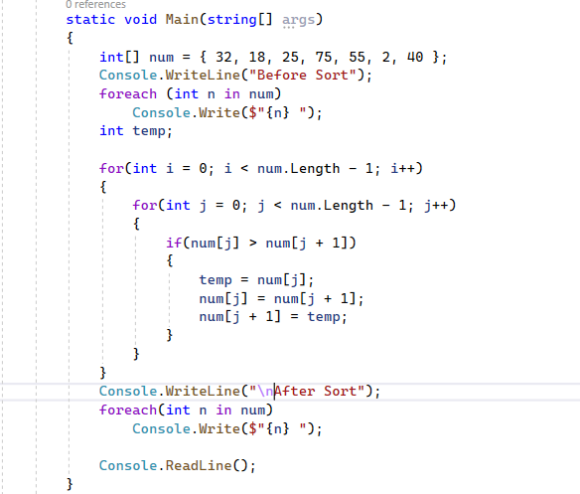
Bubble Sort

Slide 9
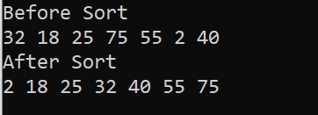
Bubble Sort

Slide 10
Linear Search
By Surya Teja Chandolu

Slide 11
Linear Search
Linear search will perform a sequential search of item in the given array. Every element is checked from start to end and if a match is found, the index of matched element will be returned
If the element input = 25

Slide 12
Linear Search
32 | 55 | 88 | 75 | 25 | 66 | 30
32 | 55 | 88 | 75 | 25 | 66 | 30
32 | 55 | 88 | 75 | 25 | 66 | 30

Slide 13
Linear Search
32 | 55 | 88 | 75 | 25 | 66 | 30
32 | 55 | 88 | 75 | 25 | 66 | 30
Element found at position 4

Slide 14
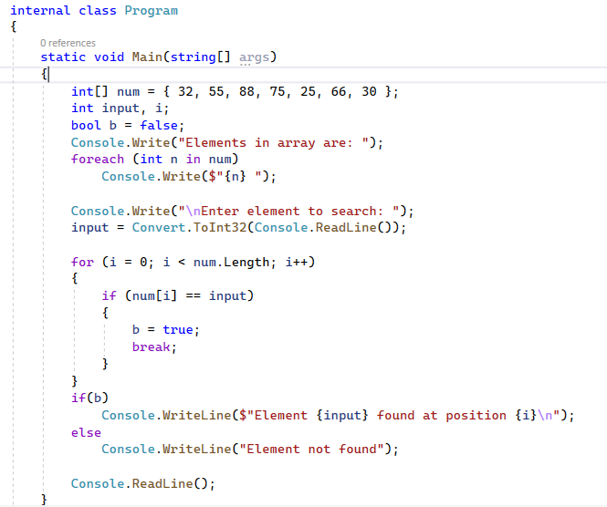
Linear Search

Slide 15
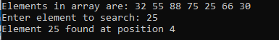
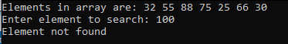
Linear Search

Slide 16
Binary Search
By Surya Teja Chandolu

Slide 17
Binary Search
Search a sorted array by repeatedly dividing the search interval in half. Begin with an interval covering the whole array. If the value of the search key is less than the item in the middle of the interval, narrow the interval to the lower half. Otherwise, narrow it to the upper half. Repeatedly check until the value is found or the interval is empty.
If the element input = 75

Slide 18
Binary Search
mid = (low + high) / 2
25 | 30 | 32 | 55 | 66 | 75 | 88
Low
Mid
if (input > num[mid])
low = mid + 1
High
25 | 30 | 32 | 55 | 66 | 75 | 88
input == num[mid]
Low
Mid
High

Slide 19
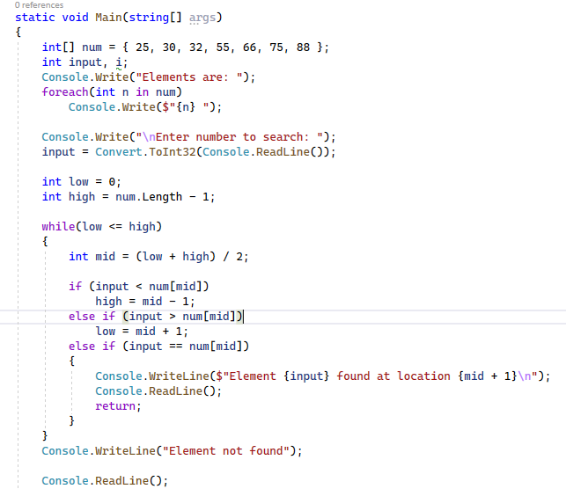
Binary Search

Slide 20
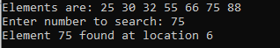
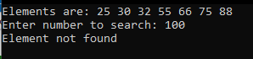
Binary Search

Slide 21


